Slide 1
Lesson 1*
How do people communicate?
*before beginning the workbooks

Slide 3
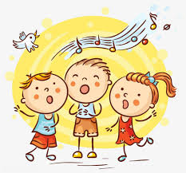

Slide 4
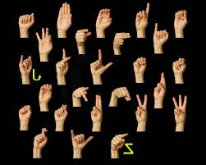

Slide 5
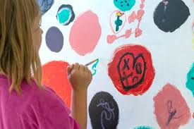

Slide 6
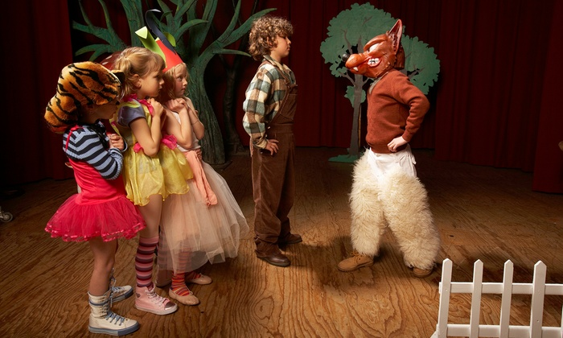

Slide 7
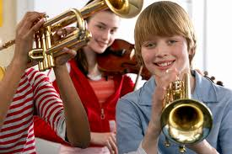

Slide 8
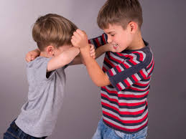
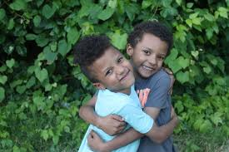

Slide 9
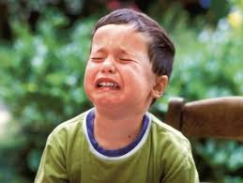
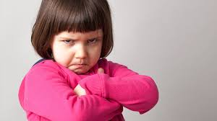
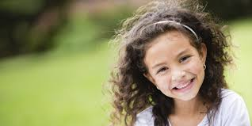
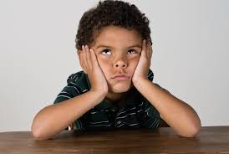

Slide 10
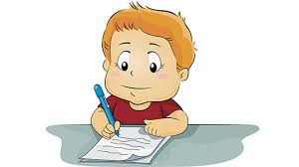

Slide 11
Writing can communicate
A feeling
A story
An idea
Important information
Facts you know
Directions

Slide 12
Some days the teacher will tell you what he or she wants you to communicate.
Some days you will decide what you want to communicate.

Slide 13
In order to communicate your feelings, thoughts, and what you know, you need an audience. Your audience is who reads or hears what you wrote. Who will your audience be this year?

Slide 14
Lesson 2*
What are writing conventions?
*before beginning the workbooks

Slide 15
What are conventions?
Conventions
are the rules
of writing.

Slide 16
Witot convetins It WiLbehrd
TooredYou r riding and thiymit
Givup
thanYu wOnT communicate
Yr grat Idas

